Slide 1
MNSCUG Agenda – 02/21/2008
Intro - 10 second introductions
  Sign in sheet
Future meetings 2008
    2/21 Thursday (Operations Manager 2007)
    3/26 Wednesday – 1e Product Demo
    4/17 Thursday
    5/21 Wednesday
    6/19 Thursday
    7/16 Wednesday
    8/21 Thursday
    9/17 Wednesday
    10/16 Thursday
    11/18 Wednesday
    12/18 Thursday

Slide 2
Meeting Ideas
Presentations
Round Table Discussions
  Room setup
  Problem / solution approach
Vendor Product Demos
MMS 2008
  Flights
  Sessions
  MN night out?

Slide 3
Berbee Sponsorship tonight
Scott Carlson
Notes:
3

Slide 4
Operations Manager 2007
Mike Kellogg

Slide 5








The System Center Family of Products
Mike Kellogg
Sr. Technology Specialist
Microsoft Corporation
mike@microsoft.com

Slide 6
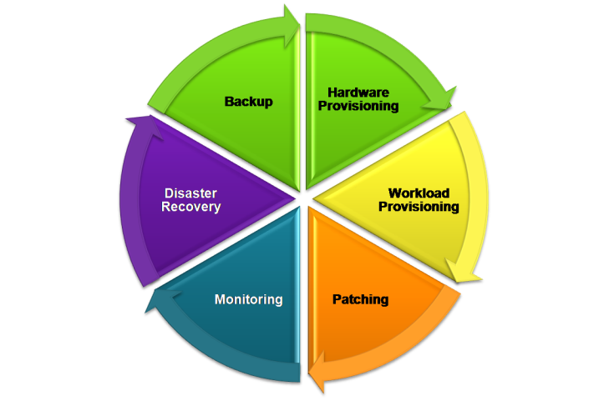




IT Management with System Center

Slide 7









Desktop Lifecycle – Enterprise View
Engineer
Deploy
Operate
Prioritize/Plan
OS, SP Distribution
Patch Management
Author and Package
Application Install
Compliance/Monitor
Security
Image Design & Mgmt
User State Migration
Data Mgmt/Recovery
Testing & App Compat
Help, Diagnose, Resolve
HW/SW Inventory/Asset
TCA “Total Cost of Acquisition”
non-recurring costs (i.e., deployment and app certification)
TCO – “Total Cost of Ownership” recurring indirect and direct costs (e.g., operations, HW, SW)
Notes:
Since our customer visits were targeted initially on “How” to deploy new desktop environments we started our discussions on:
OS migrations,
saving and restoring user state and
Application installation
Next build - Operations
As you can imagine it was tough to have a narrow discussion just deployment without discussing
Patch management technology and process to enable better security
Compliance, especially as it relates to settings and configurations,
Inventory and of course help desk implications
Next build - Engineering
We found a wide range of diversity in the level of tools and processes used to operate the environments but noticed that organizations that had the least chaotic environments and best managed environments had clear investments in Engineering their desktops for success. They generally had:
Strong inventory tools and processes
Centralized packaging teams and standards
Prescriptive test plans and automation
A few core images
Throughout this presentation we will reference these 3 areas Engineer, Deploy, and Operate as we drill into the costs and best technologies and practices to use to mitigate these costs.

Slide 8
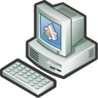
Flexible Client Monitoring
Agentless Crash Monitoring
  No agent deployment required
  Integrates with Windows Error Reporting (Watson)
  Visibility to and resolution knowledge for client crashes
  Entire Enterprise space
Collective Client Monitoring
  Reporting and alerting on collections of clients
  Proactive monitoring of errors, utilization, performance and reliability
  Remote diagnostic and troubleshooting tasks
  Medium scale within Enterprise
Business Critical Client Monitoring
  Deeper monitoring and alerting on
  individual clients
  Verified availability via heartbeat
  Host for user perspective transactions
  Optional: Security auditing capabilities
  Small scale within Enterprise
Notes:
Flexible Approach
Scales to meet diverse needs
Agentless monitoring for clients:
Easy to get up and running
Agent free deployment
Large scale monitoring of desktops
Agent monitoring for clients:
Richer monitoring for platform and applications
Synthetic transaction monitoring
Medium to small scale monitoring

Slide 9
Lack Of Awareness Of End-User Problems
Unreported issues drive productivity and satisfaction down and costs up
Productivity/Cost Implications
Productivity losses
Potential data loss
No IT awareness
Root problem not fixed
All costs above and…
Help desk FTE cost
Additional productivity
loss in time with helpdesk
All costs above and…
One-off escalations
often low priority
Little ability to track problems from changes
(i.e., patch, new app)
Desktop Crash!
>90%⁽¹⁾
Reboot
Most common end-user behavior
+
Resolve
Known error
fielded before
Call Help Desk
Few help desks equipped to resolve
<10%⁽¹⁾
+
Escalate
Desktop Admin likely see <5%
of crashes
(1) CER TAP participant interviews; MS Help desk qualitative discussions
Notes:
IT Manager and Desktop support specialist
Clients are a critical part of end-to-end service delivery and support
As a platform service for the business
Where the end user experience happens
Many roles including desktops, kiosks, POS
Lack of awareness of End-user problems
Unable to correlate problems to changes in Enterprise
Client Crashes result in loss of productivity, customer satisfaction
Additional cost in helpdesk resolution
No association with available solutions

Slide 10

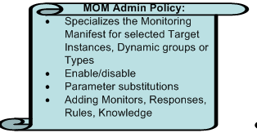


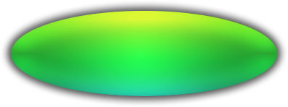
Agentless Exception Monitoring
Watson.microsoft.com
\\momserver\errordata
Enables collection, viewing and reporting of application and operating system crashes
Acquiring, viewing and editing
knowledge response
Leverages Watson and Windows Error
reporting clients
Allows Enterprises to manage flow of
crash information
Aggregates Error data for reporting
Scales to the entire Enterprise
HTTP(s)://momserver/Watson
Notes:
Change arrow to line

Slide 11
Agentless Exception Monitoring
DEMO
Installation and Configuration

Slide 12
Client Monitoring
Flexible Approach
Agentless Crash Monitoring
  No agent deployment required
  Integrates with Windows Error Reporting (Watson)
  Visibility to and resolution knowledge for client crashes
  Entire Enterprise space
Level 2 – Client Monitoring
Collective Client Monitoring
  Reporting and alerting on collections of clients
  Proactive monitoring of errors, utilization, performance and reliability
  Remote diagnostic and troubleshooting tasks
  Medium scale within Enterprise
Business Critical Client Monitoring
  Deeper monitoring and alerting on
  individual clients
  Verified availability via heartbeat
  Host for user perspective transactions
  Optional: Security auditing capabilities
  Small scale within Enterprise
Notes:
Flexible Approach
Scales to meet diverse needs
Agentless monitoring for clients:
Easy to get up and running
Agent free deployment
Large scale monitoring of desktops
Agent monitoring for clients:
Richer monitoring for platform and applications
Synthetic transaction monitoring
Medium to small scale monitoring

Slide 13
Agent Managed Clients
Monitoring requirement scale to fit goals
  Monitor a collection of clients for medium scale
  Business critical desktop for smaller scale
Agents resilient in disconnected
client environment
Agent scalability depends on level of
client Monitoring
Use System Center Capacity planner for sizing
Notes:
Client Monitoring Agent enhancements
Configure heart-beat rate
Time and priority based queue management
Customers will be able to use System Center Capacity Planner to proper size the Operations Manager environment. The tool will help them make Operations Manager topology and scalability decisions based on the management pack configurations that they’d like to choose.

Slide 14
Client Monitoring
Flexible Approach
Agentless Crash Monitoring
  No agent deployment required
  Integrates with Windows Error Reporting (Watson)
  Visibility to and resolution knowledge for client crashes
  Entire Enterprise space
Level 3 – Client Monitoring
Collective Client Monitoring
  Reporting and alerting on collections of clients
  Proactive monitoring of errors, utilization, performance and reliability
  Remote diagnostic and troubleshooting tasks
  Medium scale within Enterprise
Business Critical Client Monitoring
  Deeper monitoring and alerting on
  individual clients
  Verified availability via heartbeat
  Host for user perspective transactions
  Optional: Security auditing capabilities
  Small scale within Enterprise
Notes:
Flexible Approach
Scales to meet diverse needs
Agentless monitoring for clients:
Easy to get up and running
Agent free deployment
Large scale monitoring of desktops
Agent monitoring for clients:
Richer monitoring for platform and applications
Synthetic transaction monitoring
Medium to small scale monitoring

Slide 15
Business Critical Clients
Any client which is critical to the
businesses performance
  Point of Sale terminals
  Kiosks
  Bank ATMs
  High impact client systems
Need to be monitored and reported
on individually like a server

Slide 16
Windows Desktop Management Packs
Management Packs for
  Windows Vista, Windows XP
  Designed for Collective and Business Critical Clients
Features Include
Availability and Reliability
  Service Availability
  Service Failures
  Storage Availability (NEW) *
  Storage Capacity Issues (NEW) *
  Performance Sub-System Issues
Performance
  Shell Responsiveness (NEW) *
  Monitor Abnormalities for KPIs (NEW) *
  Measuring for KPI’s (NEW)
  OS Startup/Shutdown Performance (NEW) *
Hardware and Configuration
  Application Compatibility Issues (NEW) *
  Service Configuration Issues
  Share Configuration Issues
  Disk and Memory Failures and Issues (NEW) *
Views
  Standard Views
  System Performance Dashboards (NEW)
  Reliability Views
Tasks
  System Information
  Network Diagnostics
  System Restart/Shutdown
  Process Diagnostics (NEW)
Reports
  Global Reports
  Desktop Monitoring Dashboard (NEW) *
  Desktop Memory Report (NEW) *
  Desktop Disk Health Report (NEW) *
  Desktop Performance (NEW) *
  Purchasing Reports (NEW) *

Slide 17
Information Worker Management Pack
Platform and Version Coverage
  Windows 2000 Professional, XP, and Windows Vista; Office 2007,XP, 2003, 2000
Designed for Collective and Business Critical Client Monitoring
Availability Monitoring
  Crash and Hang Management
  Outlook Mail Availability
  Internet Explorer Site Availability
  Data source (Database) Availability
  File Server and File Availability
Global Collective and Business Critical Monitoring
  Are my IW applications crashing or hanging?
  Are my IW applications consuming to many resources?
  Are my IW applications responsive for end users?
Application Specific Collective and Business Critical Monitoring
  Are Office Outlook clients able to send receive mail?
  Is Windows Internet Explorer able to access sites?
  Is Windows Client Desktop able to access data sources (e.g., DB)?
  Is Windows Client Desktop able to access shares and files?
Performance Monitoring
  Resource Utilization Management
  Responsiveness Management

Slide 19

© 2007 Microsoft Corporation. All rights reserved. Microsoft, Windows, Windows Vista and other product names are or may be registered trademarks and/or trademarks in the U.S. and/or other countries.
The information herein is for informational purposes only and represents the current view of Microsoft Corporation as of the date of this presentation. Because Microsoft must respond to changing market conditions, it should not be interpreted to be a commitment on the part of Microsoft, and Microsoft cannot guarantee the accuracy of any information provided after the date of this presentation.
MICROSOFT MAKES NO WARRANTIES, EXPRESS, IMPLIED OR STATUTORY, AS TO THE INFORMATION IN THIS PRESENTATION.

